Slide 1

Steam Video Game Data
Michael Hart
Information Visualization
Spring 2020

Slide 2
Introduction
This is a dataset of all video games sold on the popular digital game distribution platform Steam. The dataset was put together from information made publicly available by Valve Software, and contains data on game release dates, text descriptions of the game content, genres, reviews, developers, publishers, user-generated reviews, average playtimes, and number of owners.
This dataset is limited to video game activity on Windows, Mac, and Linux systems, but provides much more fine-grain detail due to Steam’s in-built analytics. The visualization created from this dataset would be useful for sales and marketing teams in the video gaming industry, investors who want to know which game developers/publishers are the most successful, and video game shoppers who are looking for suggestions for their next purchase.

Slide 3
Questions
Of Interest to Game Companies & Investors:
Which game genres are most profitable?
Is there a correlation between the percentage of positive/negative ratings and the number of purchases?
Do the most-purchased games generally have good reputations?
Which game developers and publishers have the best reputations?
Which game developers and publishers are the most successful?
Text Analysis:
What words are most commonly used the marketing descriptions of the top 50 games from the past four years?
Which terms are associated with each other in the text?
Of Interest to Video Game Shoppers:
What games of a particular genre are popular and have mostly positive reviews?
Which games are the most addictive and time-consuming?
Is the average playtime for games distorted by a small number of obsessive gamers?

Slide 4
Data Cleanup
Some games had been purchased many times, but had zero hours of play recorded, so I removed them from the dataset.
Money-laundering?
Removed terms such as “indie” and “free-to-play” from the Genre field, since they don’t describe a game’s genre.
Changed multi-genre games into one genre (e.g. “action-adventure” → “adventure”)
Had to clean up characters such as apostrophes that got converted incorrectly when pasted into Excel from Steam.

Slide 5
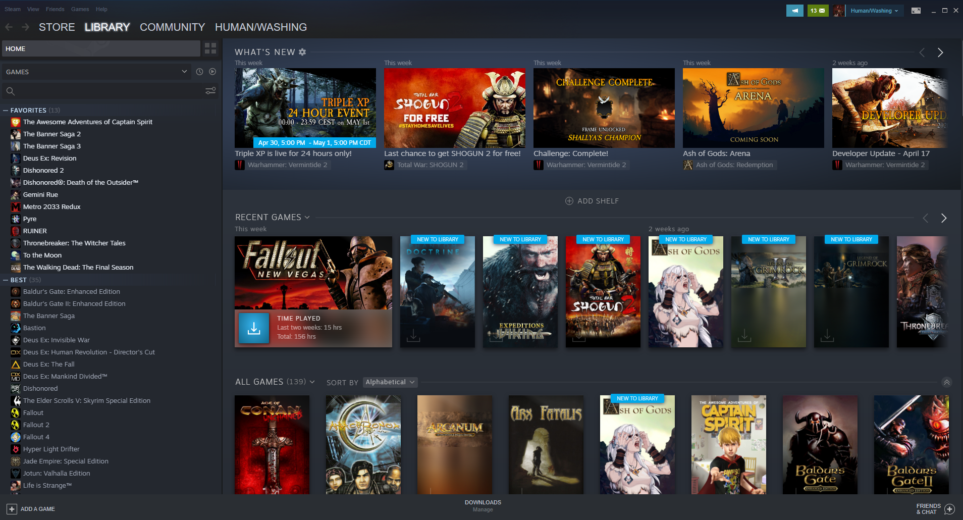
Steam Library Screenshot

Slide 6
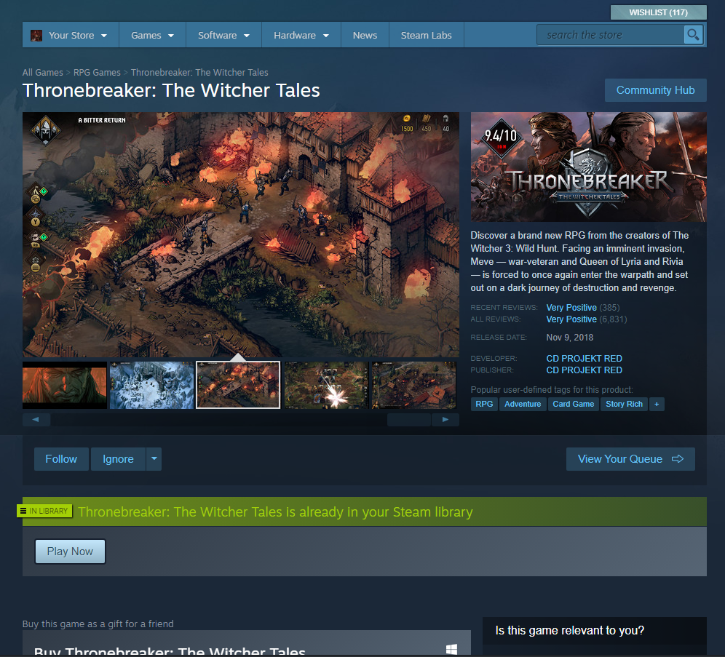
Steam Store

Slide 7
Steam Store

Slide 8
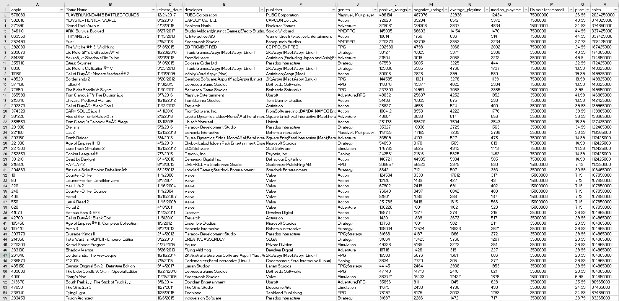
View of Dataset in Excel

Slide 9

Word Cloud (Voyant)

Slide 10
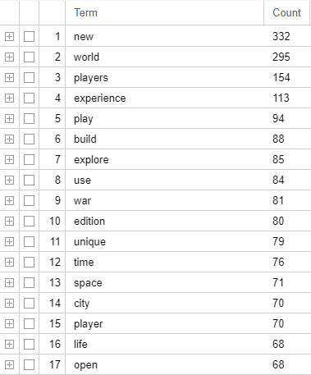
Word Count (Voyant)

Slide 11
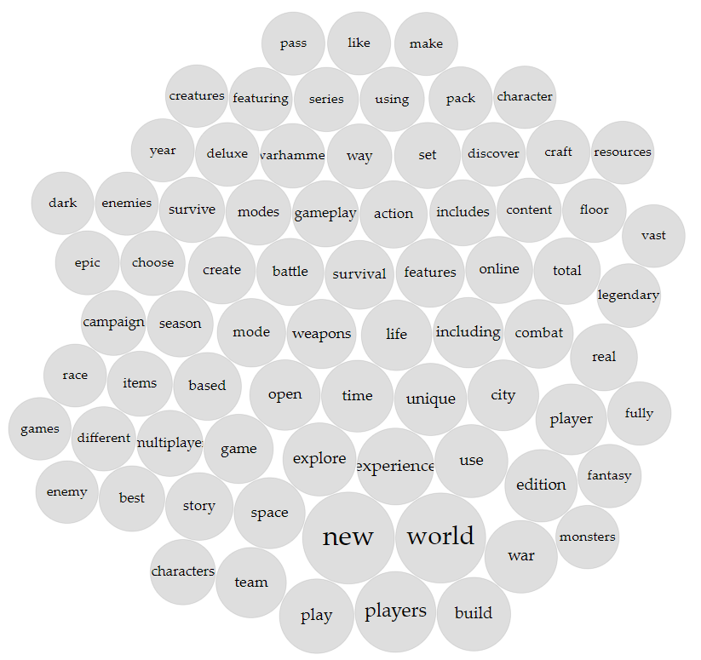
Voyant TermsBerry https://voyant-tools.org/?corpus=c420fbb6646f6c425088cb4466ff2933&view=TermsBerry

Slide 12
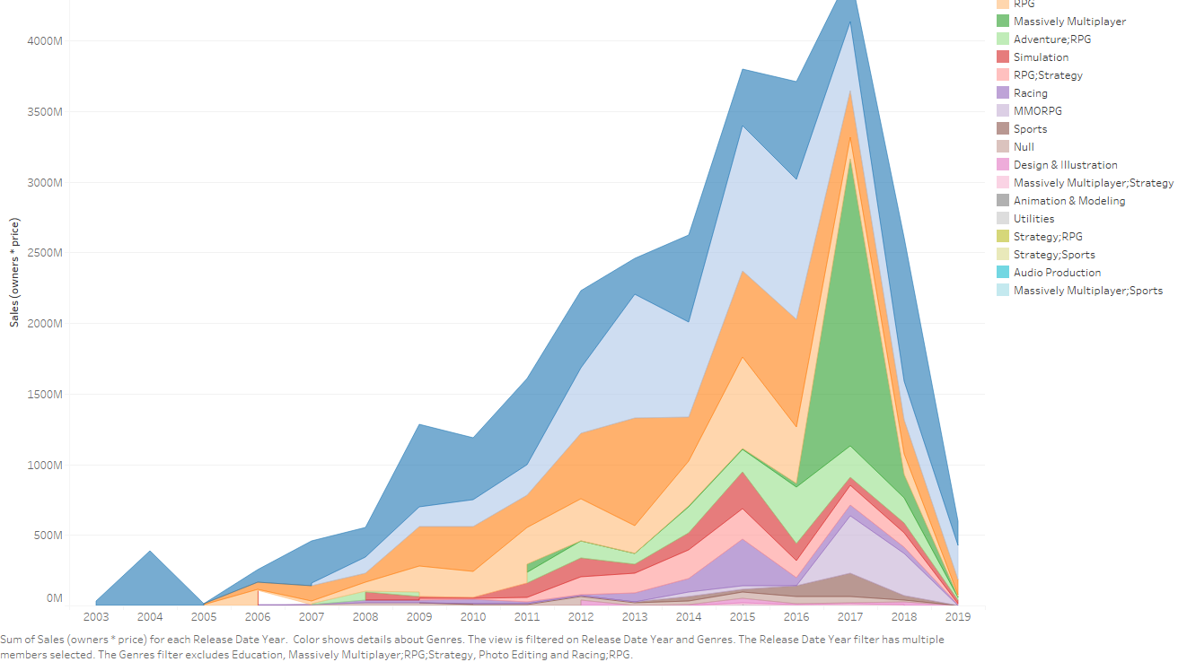
Which game genres are most profitable?

Slide 13
Tableau Public:
https://public.tableau.com/views/MichaelHartFinalProject/ProfitabilityTimeSeries?:display_count=y&publish=yes&:origin=viz_share_link

Slide 14
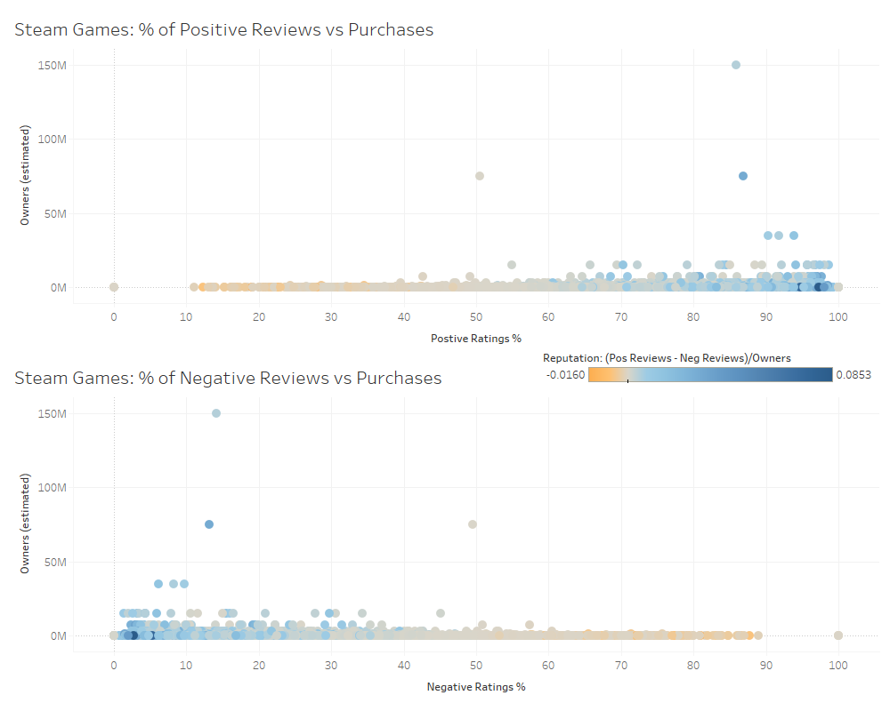

Slide 15
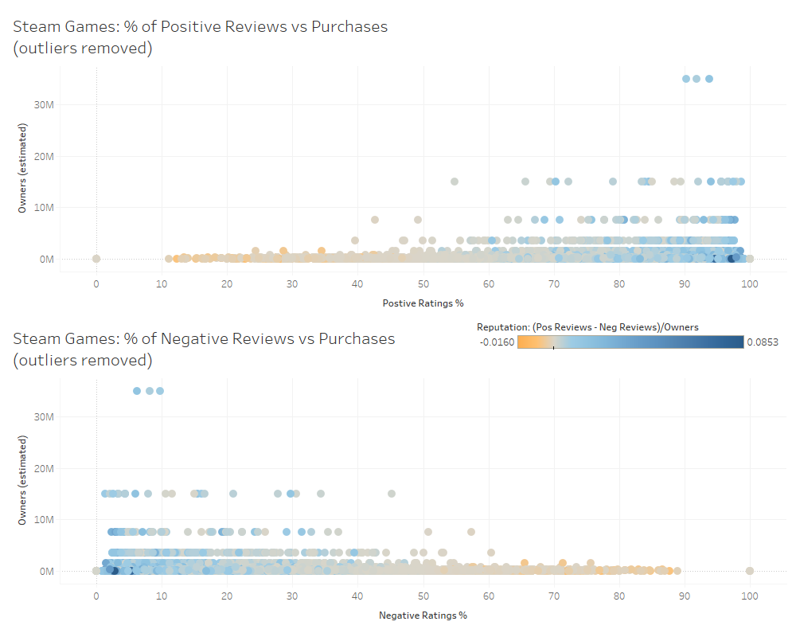
Tableau Public:
https://public.tableau.com/views/MichaelHartFinalProject/PurchasesReviewsoutliersremoved?:display_count=y&publish=yes&:origin=viz_share_link

Slide 16
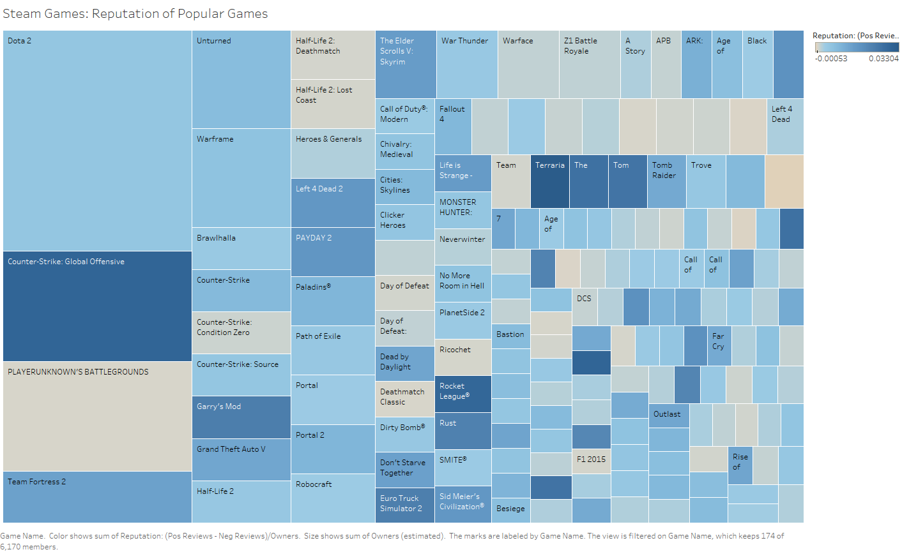
Do the most-purchased games generally have good reputations?

Slide 17
Tableau Public:
https://public.tableau.com/views/MichaelHartFinalProject/ReputationsofPopularGames?:display_count=y&publish=yes&:origin=viz_share_link

Slide 18
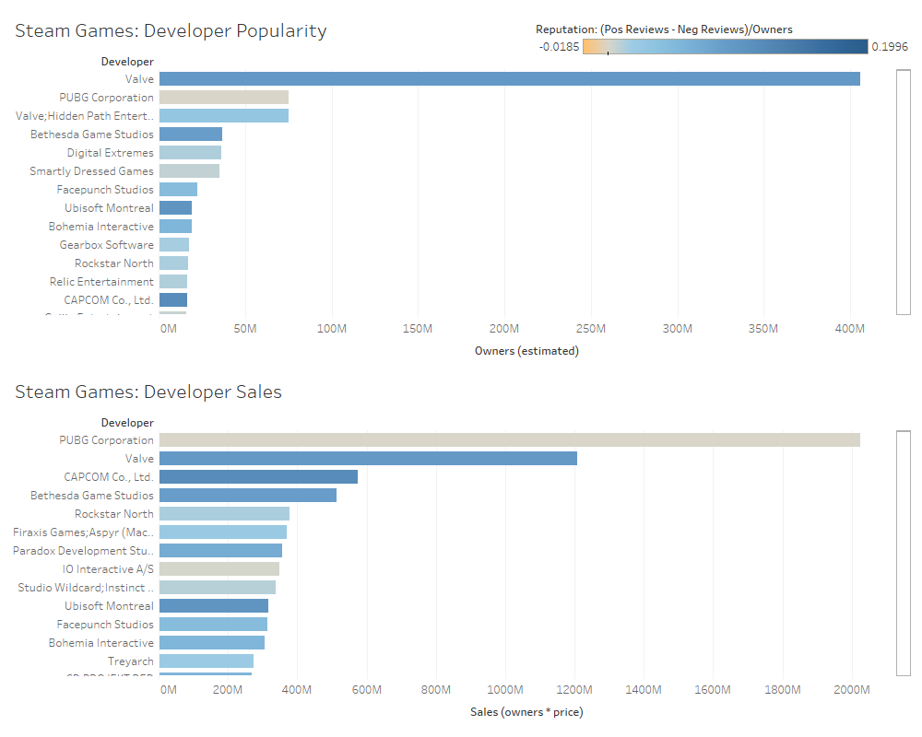
Which game developers & publishers are the most Popular & successful?
Tableau Public:
https://public.tableau.com/views/MichaelHartFinalProject/SuccessfulDevelopers?:display_count=y&publish=yes&:origin=viz_share_link

Slide 19
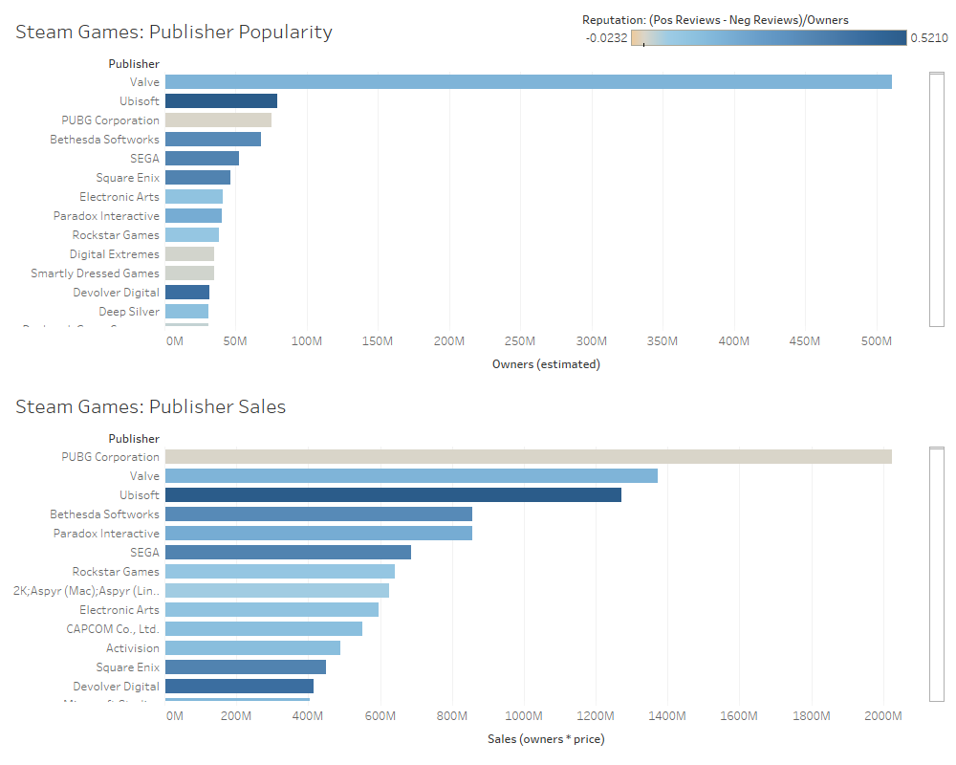
Which game developers & publishers are the most Popular & successful?
Tableau Public:
https://public.tableau.com/views/MichaelHartFinalProject/SuccessfulPublishers?:display_count=y&publish=yes&:origin=viz_share_link

Slide 20
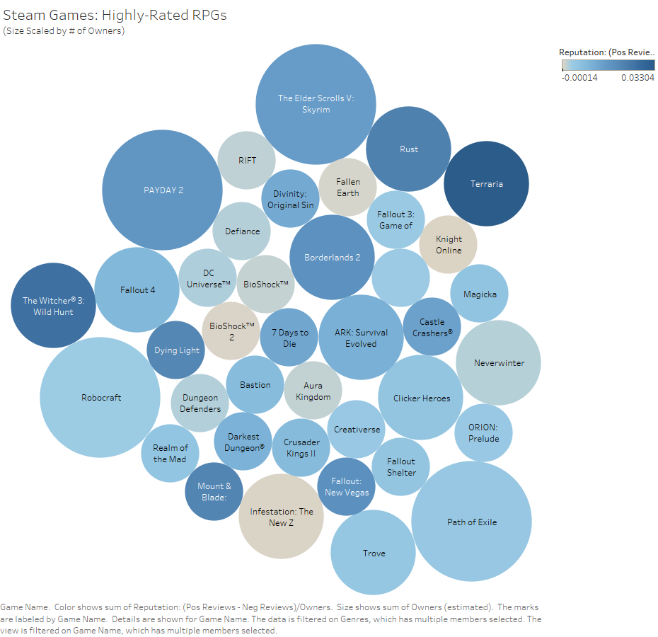
What games of a particular genre are popular & have mostly positive reviews?

Slide 21
Tableau Public:
https://public.tableau.com/views/MichaelHartFinalProject/Highly-RatedRPGs?:display_count=y&publish=yes&:origin=viz_share_link

Slide 22
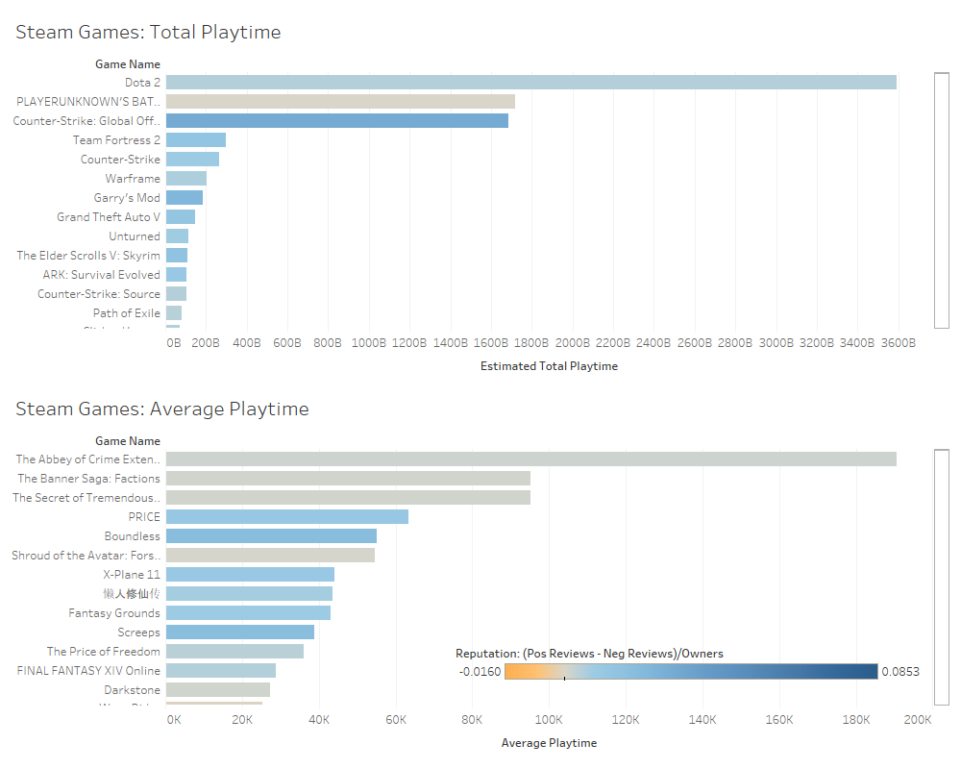
Are the games with the highest average playtime different from the games with the highest total playtime?
Tableau Public:
https://public.tableau.com/views/MichaelHartFinalProject/PlayTime?:display_count=y&publish=yes&:origin=viz_share_link

Slide 23
Sources
Chavarria, I. (2017, August 2). Predicting video game hits with Machine Learning. Retrieved from https://towardsdatascience.com/predicting-hit-video-games-with-ml-1341bd9b86b0
Davis, N. (2019, May). Steam Stores Games (Clean dataset). Retrieved from https://www.kaggle.com/nikdavis/steam-store-games#steam_description_data.csv
Sinclair, S. & G. Rockwell. (2020). Voyant Tools. Retrieved May 3, 2020, from https://voyant-tools.org/?panels=collocatesgraph%2Creader%2Ctrends%2Cphrases%2Cbubblelines&corpus=c420fbb6646f6c425088cb4466ff2933

